Slide 1


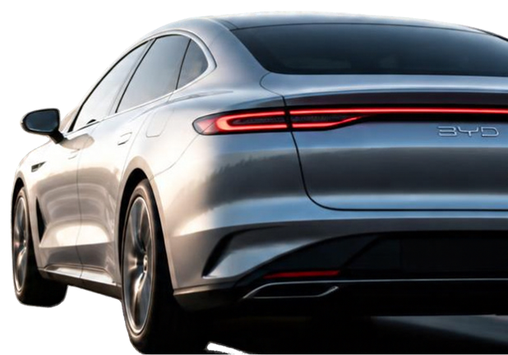
HOW DATA HELPED BYD WORK SMARTER
Data-led decisions. Measurable impact.
Himanshu Mohanty
E-mail Address
Linkedin

Slide 2




ABOUT BYD
Founded in 1994, BYD is a global technology company operating across automobile, electronics, new energy and rail transit.
1994
4
Year founded
Core industries
2.21M
4.2%
Vehicles sold by Sep 2024
Global automotive market share
Core technologies
Blade battery
E-platform 3.0
Intelligent driving

Slide 3





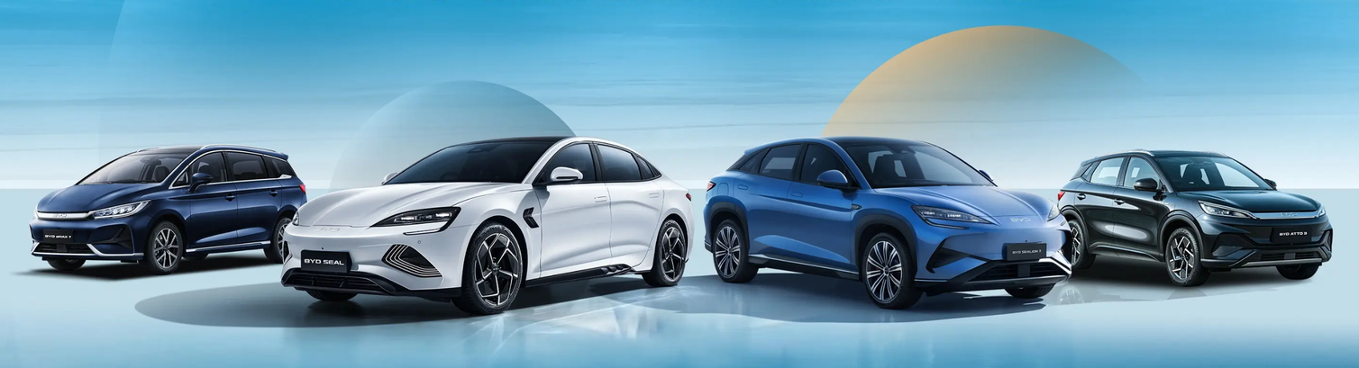
GROWING FAST
CREATED BIG HEADACHES
R&D
6
45
slow physical crash testing and long development cycles
FACTORY
DAYS
MONTHS
45 days to deliver hit models like Song PLUS
Delivery Cycle
per intelligent-driving update
MARKETING
one-size-fits-all outreach to 20 million users
AFTER-SALES
faults fixed only after they happen

Slide 4






SOLUTION
SMART R&D
SMART FACTORY
SMART CUSTOMER
Digital twin simulation
1,000 robots, 95% automation
CRM of 20M users with RFM targeting
100,000 virtual crash tests
on Han EV
28,000 IoT nodes track
3,000 parameters
Live-stream and VR test drives
6 global R&D centers share one cloud platform
AI predicts maintenance
T-BOX sends 120 data points, warns 30 days ahead

Slide 5






RESULT
Data-driven decisions delivering measurable impact across our business.
40%
Shorter R&D cycles
Delivery cycle for Song PLUS
Days from order to delivery
67%
Higher production capacity
45
30
60%
Less downtime
15
days faster
96
Customer satisfaction
NPS 68
27%
Higher conversion from targeted marketing
Before
After

Slide 6




INSIGHTS
01
02
03
DATA SPEEDS
UP EVERYTHING
FLEXIBLE
FACTORIES
BEAT UNCERTAINTY
PREDICTIVE
SERVICE WINS
CUSTOMERS
Simulation cut R&D by 40%
12 models on one line
82% remote fault resolution
Iteration of intelligent driving from 6 to 3 months
Inventory turnover up 40%
2-hour on-site response
Only 12% of digital team have AI + automotive skills
Predictive maintenance - 82% accuracy vs 90% target
Europe configuration errors 1.8x China
Cloud outage halted logistics for 5,000 vehicles for 3 hours
STILL TO IMPROVE

Slide 7




THANK YOU
ANY QUESTIONS?
Thank you for your time and attention.
We appreciate the opportunity to share how data helps BYD work smarter.
Liu, Y. (2026). Take BYD as an Example to Analyze the Digital Transformation Strategy of China's New Energy Vehicle Enterprises. Proceedings of ICHCH 2025, Advances in Economics, Business and Management Research 374.
BYD Case Study

